Slide 1
IT694 Computer Networks
Week 7_Lec1

Slide 2
TCP Congestion
First, what should be done to UNDERSTAND congestion?
Sender
Receiver
What is congestion?
Where does it occur?
Why?
how does a TCP sender limit the rate at which it sends traffic into its connection?
Second, how does a TCP sender perceive that there is congestion on the path between itself and the destination?
What logic/algorithm should the sender use to change its send rate as a function of perceived end-to-end congestion?

Slide 3
A lost segment implies congestion, and hence, the TCP sender’s rate should be decreased when a segment is lost
An acknowledged segment indicates that the network is delivering the sender’s segments to the receiver, and hence, the sender’s rate can be increased when an ACK arrives for a previously unacknowledged segment.
Bandwidth probing

Slide 4
TCP congestion control: details
sender sequence number space
TCP sending behavior:
roughly: send cwnd bytes, wait RTT for ACKS, then send more bytes
cwnd
last byte
ACKed
cwnd
sent, but not-yet ACKed
(“in-flight”)
available but not used
TCP rate
~
bytes/sec
~
RTT
last byte sent
TCP sender limits transmission:
cwnd is dynamically adjusted in response to observed network congestion (implementing TCP congestion control)
<
cwnd
LastByteSent- LastByteAcked

Slide 5
TCP congestion control: AIMD
approach: senders can increase sending rate until packet loss (congestion) occurs, then decrease sending rate on loss event
Additive Increase
Multiplicative Decrease
increase sending rate by 1 maximum segment size every RTT until loss detected
cut sending rate in half at each loss event
AIMD sawtooth
behavior: probing
for bandwidth
TCP sender Sending rate
time

Slide 6
TCP AIMD: more
Multiplicative decrease detail: sending rate is
Cut in half on loss detected by triple duplicate ACK (TCP Reno)
Cut to 1 MSS (maximum segment size) when loss detected by timeout (TCP Tahoe)
Why AIMD?
AIMD – a distributed, asynchronous algorithm – has been shown to:
optimize congested flow rates network wide [Kelly]!
have desirable stability properties

Slide 7

TCP slow start
Host A
Host B
when connection begins, increase rate exponentially until first loss event:
initially cwnd = 1 MSS
double cwnd every RTT
done by incrementing cwnd for every ACK received
one segment
RTT
two segments
four segments
summary: initial rate is slow, but ramps up exponentially fast
time

Slide 8
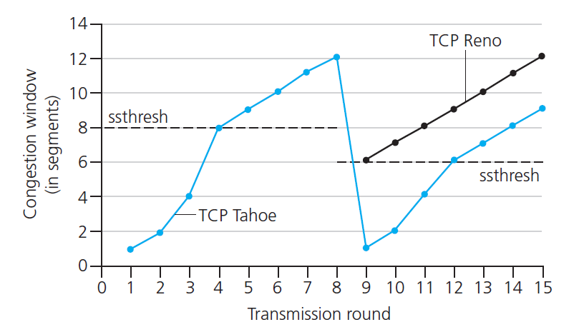

TCP: from slow start to congestion avoidance
Q: when should the exponential increase switch to linear?
A: when cwnd gets to 1/2 of its value before timeout.
X
Implementation:
variable ssthresh
on loss event, ssthresh is set to 1/2 of cwnd just before loss event
* Check out the online interactive exercises for more examples: http://gaia.cs.umass.edu/kurose_ross/interactive/

